Slide 1
Introducing Learning Algorithms within an Operational State Aggregation Method for Transmission System Planning
Kristof Phillips and Erik F. Alvarez

Slide 2
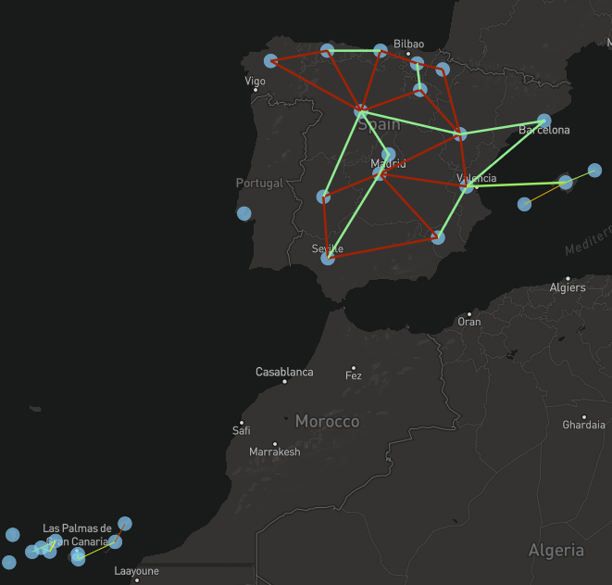
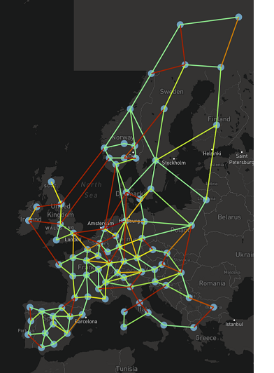
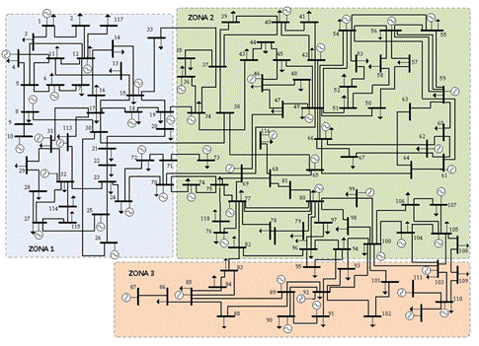
Problem setting: TEP
TEP characteristics:
Planning representation:
Static: target year (2030)
Dynamic: climate years or 2030-2050
System operation representation
Hours: 8736
Physical network
ESS
RES
Alternative features:
Techno-economical details:
Operational time-dependent constraints (unit commitment)
Operating reserves
Sector coupling with:
Gas, transport, industry, and heat
Spain ES2030
Europe TF2030
IEEE118
Case SEP2030
2’999’548 rows, 3’513’436 columns, 11’508’142 nonzeros
Case ES2030
5’162’243 rows, 6’832’942 columns, 21’554’828 nonzeros
Case TYNDP DE2050
22’157’904 rows, 26’966’415 columns, 73’814’159 nonzeros
Case IEEE118
22’380’894 rows, 28’787’324 columns, 75’025’891 nonzeros

Slide 3
Benchmark:
Full time horizon
Input Data
ESOM
Input Time Series
Clustering
Method
Representative Time Series
ESOM
Traditional:
Split time horizon
Features
Clustering
Method
Representative Time Series
ESOM
Based in Costs:
Split time horizon
Relaxed ESOM
(ANN + Kmedoids)
Clustering
Method
Proposal:
Split time horizon
ANN: Feature Estimator
Features
Representative Time Series
ESOM

Slide 4
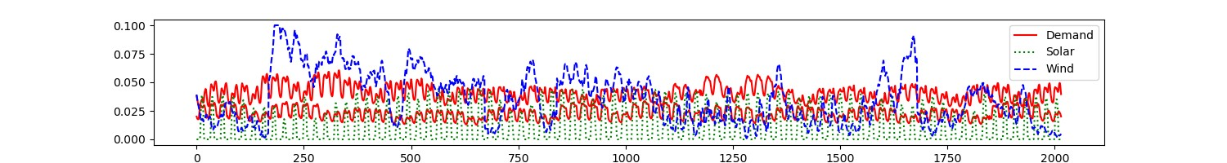
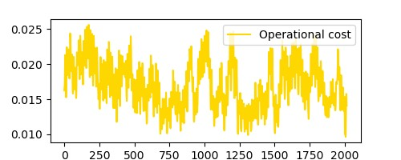
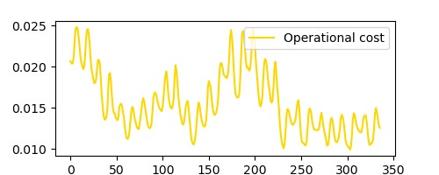
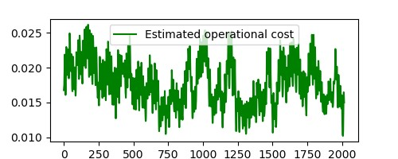
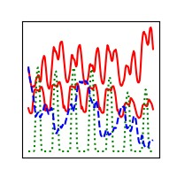
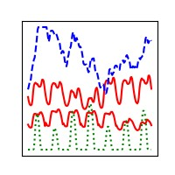
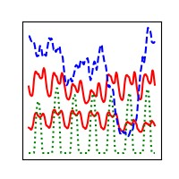
Relaxed ESOM
Relaxed ESOM
Features
Clustering
Method
Clustering
Method
Training
Evaluation
Clustering
Method
Representative Time Series
ML algorithm
NN-assisted Ex-post clustering
No temporal reduction
Input-based clustering
Ex-post clustering
ESOM
ESOM
ESOM
ESOM

Slide 5
Neural Network for cost estimation
Goal
Estimate the hourly operational cost of the OPF problem
Sensitive to
time-series changes
physical network changes
Approach
Neural network works on hourly basis → Estimates one cost value
Single output (cost)
Input contains
Demand (per node)
Renewable availability factors (per technology per location)
Investment Booleans representing physical network characteristics
Demands
Availabilities
Investment booleans
Input layer
…
…
…
Hidden layer
…
Single output
Operational cost for one hour

Slide 6
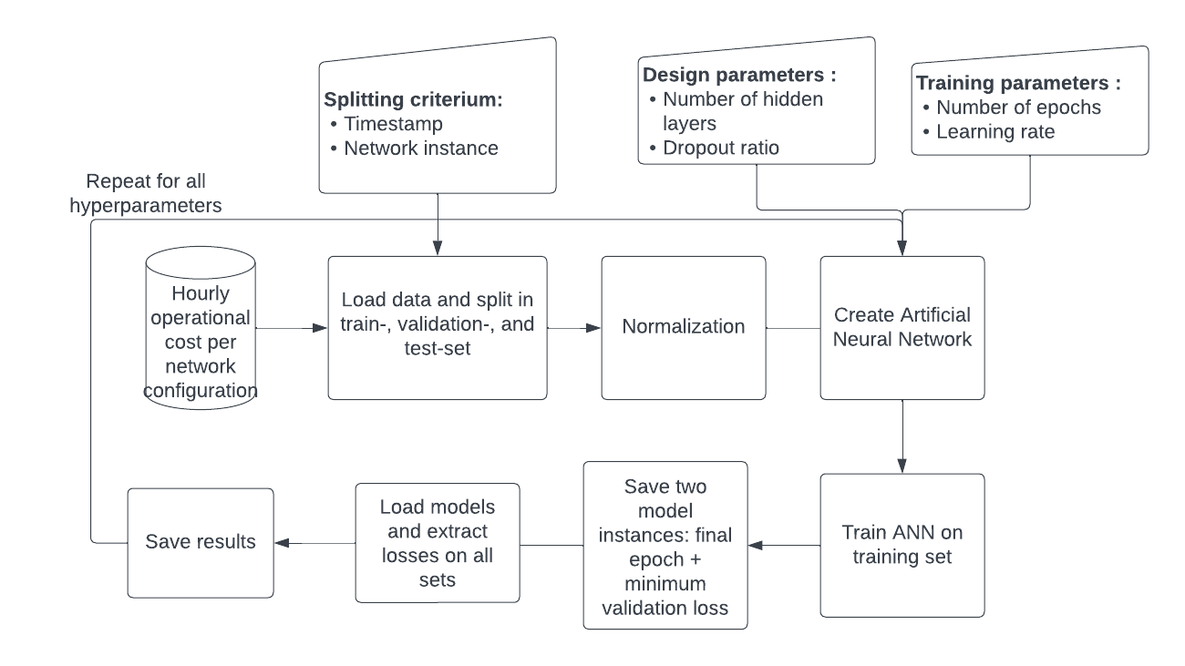
Neural network training
Goal
Train and test on a subset of desired outcomes
Achieve speedup by obtaining remaining outcomes with NN instead of optimization
Approach
Optimization performed for
Set of 84 random days
All individual line candidates
Split obtained dataset into training and test sets
Tune network design to obtain best result on test set

Slide 7
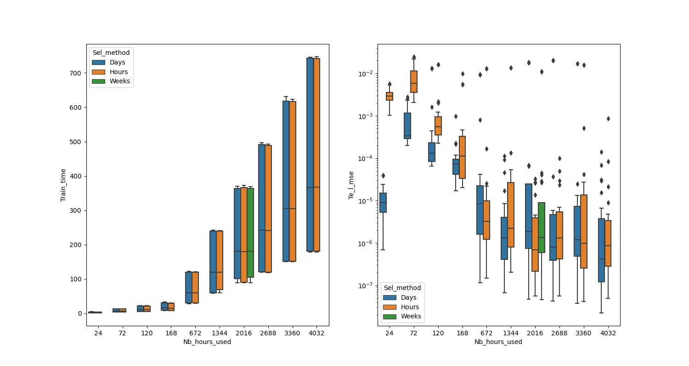
Neural network training
Goal
Train and test on a subset of desired outcomes
Achieve speedup by obtaining remaining outcomes with NN instead of optimization
Approach
Optimization performed for
Set of 84 random days
All individual line candidates
Split obtained dataset into training and test sets
Tune network design to obtain best result on test set

Slide 8
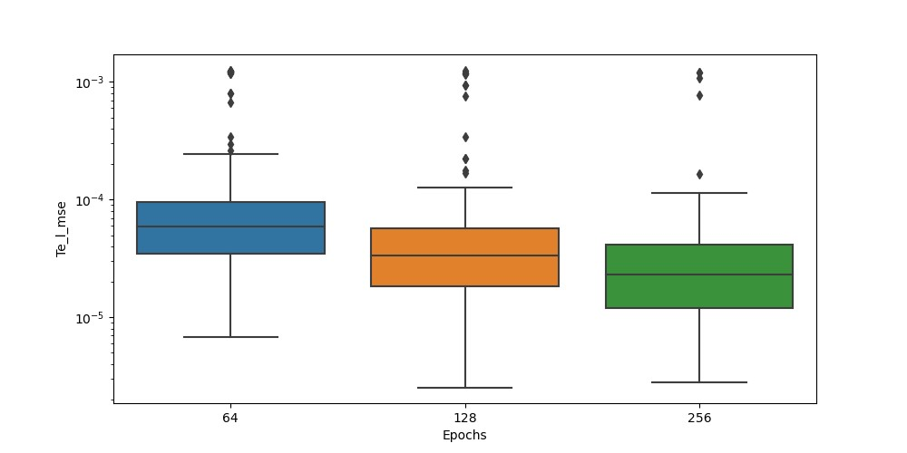
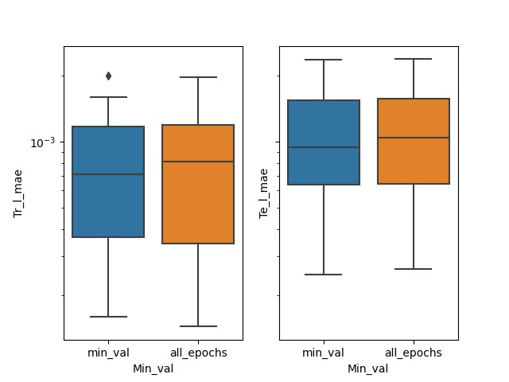
Neural network training
Goal
Train and test on a subset of desired outcomes
Achieve speedup by obtaining remaining outcomes with NN instead of optimization
Approach
Optimization performed for
Set of 84 random days
All individual line candidates
Split obtained dataset into training and test sets
Tune network design to obtain best result on test set

Slide 9
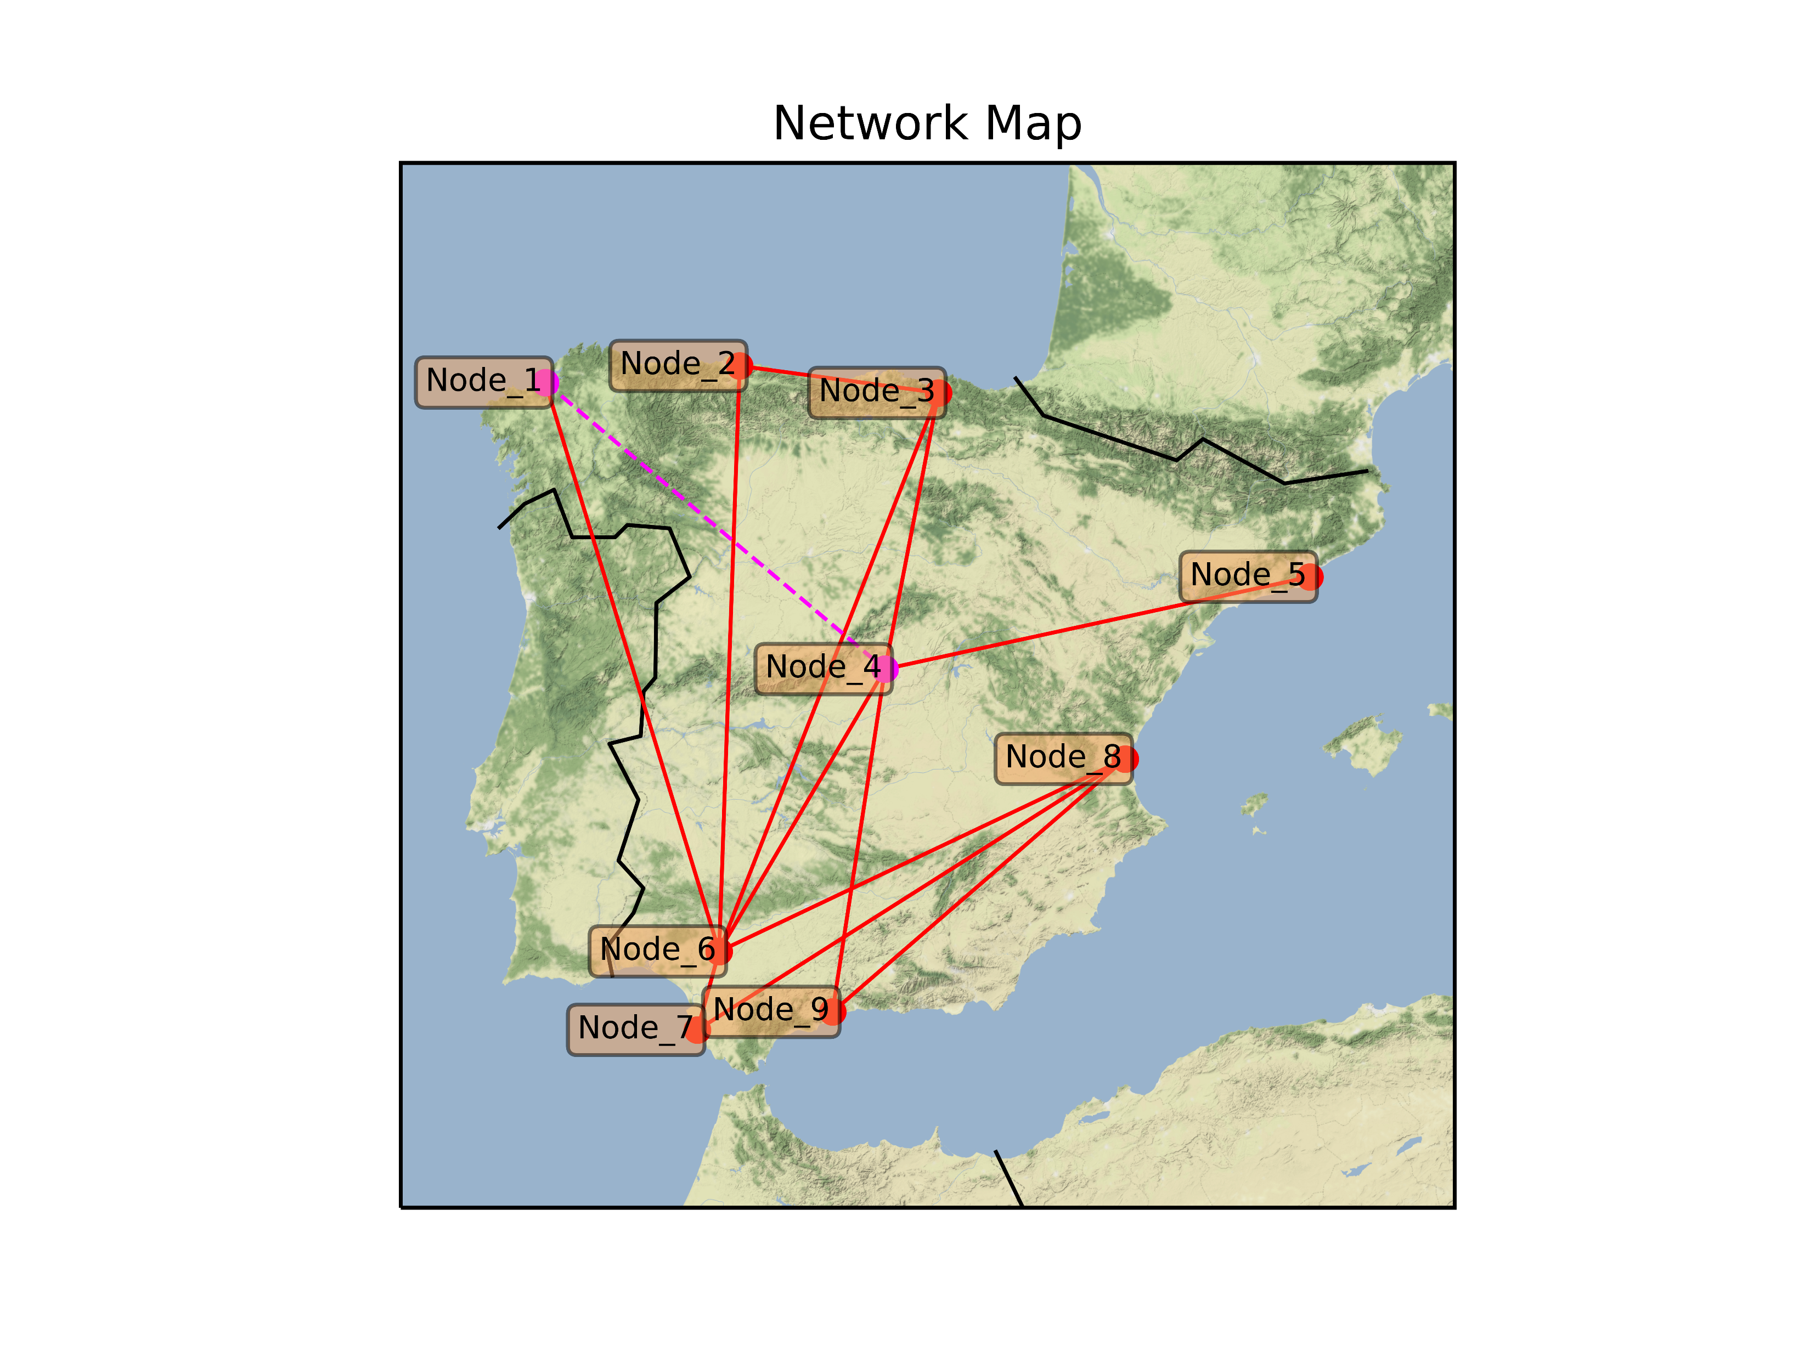
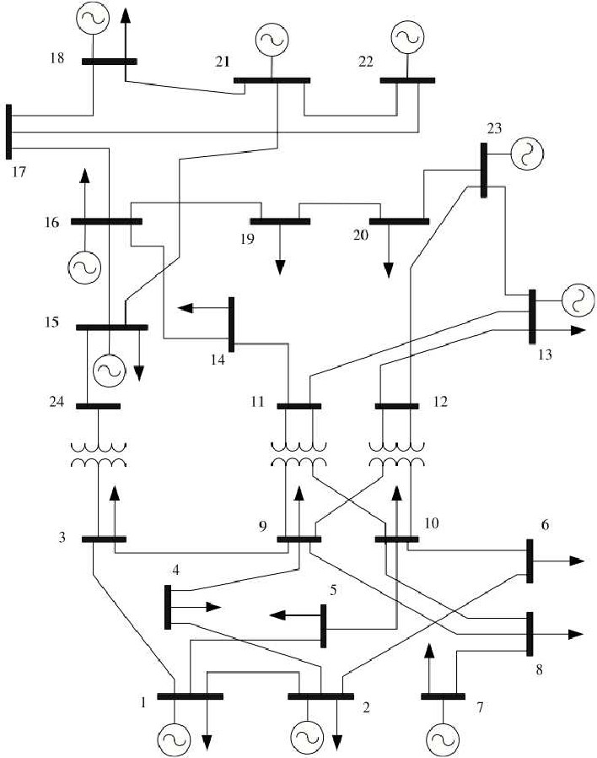
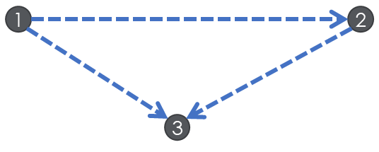
Cases studies
3-bus
9n
RTS24
Peak Load
260.75 MW
Installed Thermal Capacity
400 MW
Installed RES Capacity
150 MW
Existing Transmission
3 lines
Candidate Transmission
9 lines
Cont. Variables*
171’277
Constraints*
349’440
Solving Time
181 sec.
Peak Load
1618.33 MW
Installed Thermal Capacity
3716.8 MW
Installed RES Capacity
2400 MW
Existing Transmission
12 lines
Candidate Transmission
36 lines
Cont. Variables*
171’277
Constraints*
349’440
Solving Time
924 sec.
Peak Load
2552.13 MW
Installed Thermal Capacity
3318 MW
Installed RES Capacity
3646 MW
Existing Transmission
34 lines
Candidate Transmission
21 lines
Cont. Variables*
969’401
Constraints*
1’009’078
Solving Time
220’748 sec.
*After presolve

Slide 10
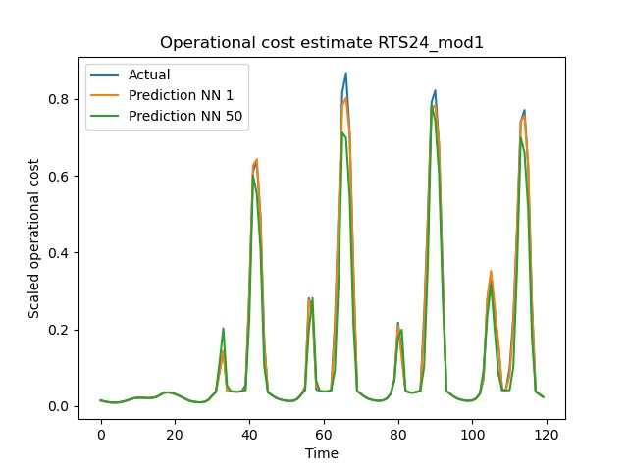
Operational cost estimation

Slide 11
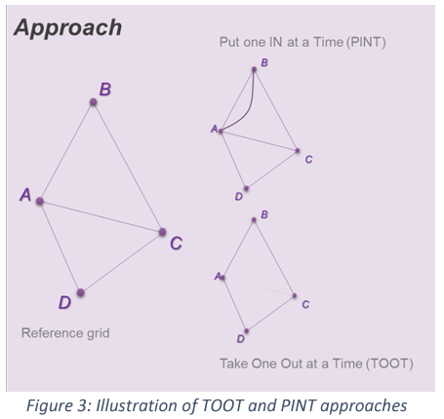
Line benefits
The PINT and TOOT
Features
Sequence per candidate asset and hour
PINT (or TOOT)
Reference grid
ANN Cost
Estimator
ANN Cost
Estimator
Line Benefit Methods:
The Put IN one at the Time (PINT)
The Take Out One at the Time (TOOT)
Shapley value
Aumann-shapley value
Benefit 1 (Benefit 2) =
Reference grid – PINT
(TOOT – Reference grid)
[source] ENTSO-E: Guideline for Cost Benefit Analysis of Grid Development Projects
Link: https://eepublicdownloads.entsoe.eu/clean-documents/tyndp-documents/Cost%20Benefit%20Analysis/191023_CBA3_Draft%20for%20consultation.pdf
Disadvantages of the PINT (TOOT):
Computationally expensive

Slide 12
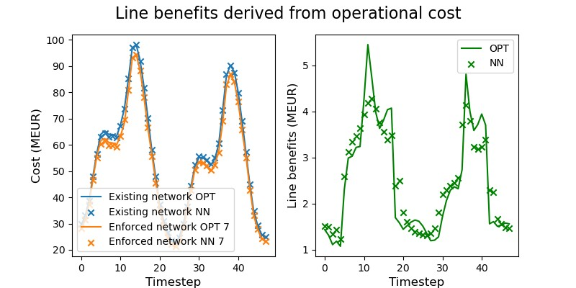
Line benefits estimation

Slide 13
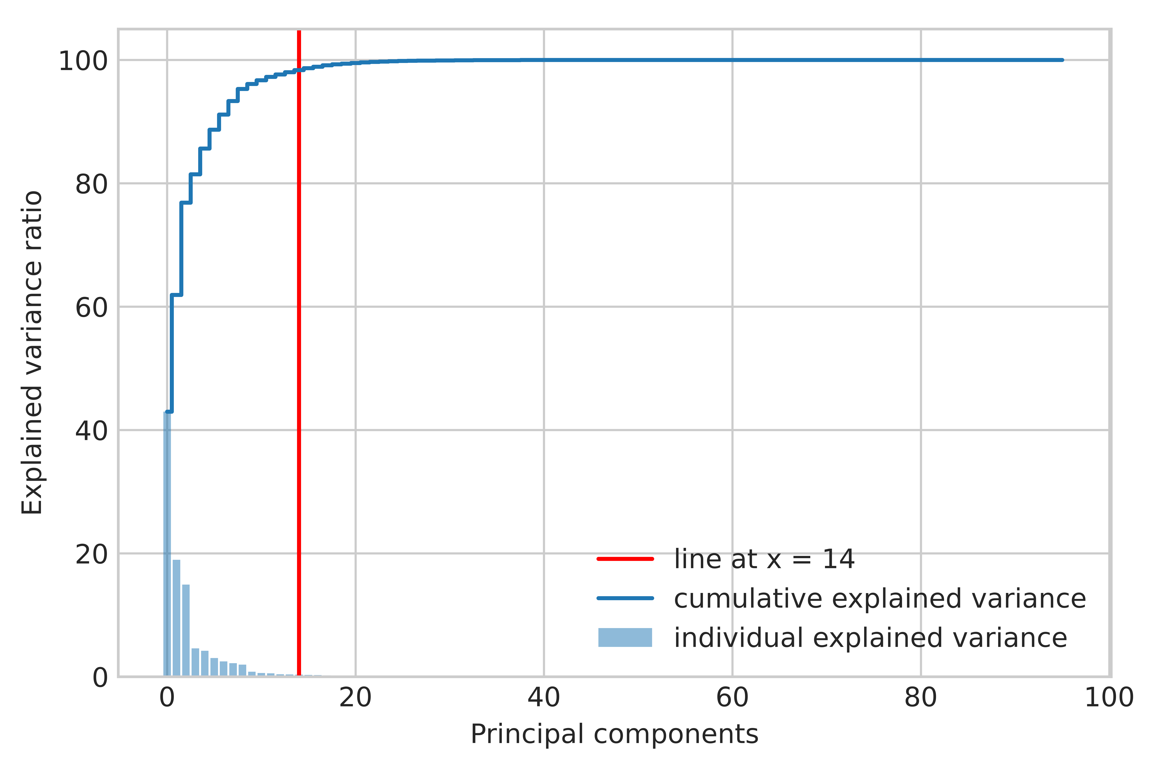
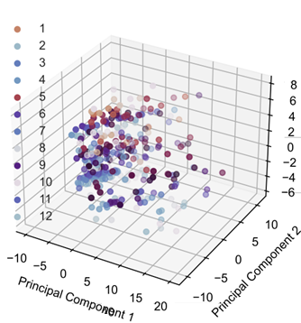
Clustering process
Dimensionality reduction
Classification of operational states into 3 subsets: positive/negative significative and non-significative states
Computation of the optimal K-medoids
Selection of the representative operational states and their weights
Dimensionality reduction using PCA
Optimal number of centroids:
Elbow method

Slide 14
Benchmarking: Definition
Relaxed ESOM
Relaxed
TEP
Features
Operational Cost
Line Benefits
Operational Cost
Line Benefits
Clustering
Method
Clustering
Method
Clustering
Method
Training
Clustering
Method
Evaluation
Representative Time Series
ML algorithm
NN-assisted Ex-post clustering
Representative Time Series
Representative Time Series
Representative Time Series
No temporal reduction
Input-based clustering
Ex-post clustering
TEP
TEP
TEP
TEP
TEP
Fixing
Fixing
Fixing
Fixing
Full Year Operation
Full Year Operation
Full Year Operation
Full Year Operation
Solution A
Solution D
Solution B
Solution E
Solution F
Solution G

Slide 15
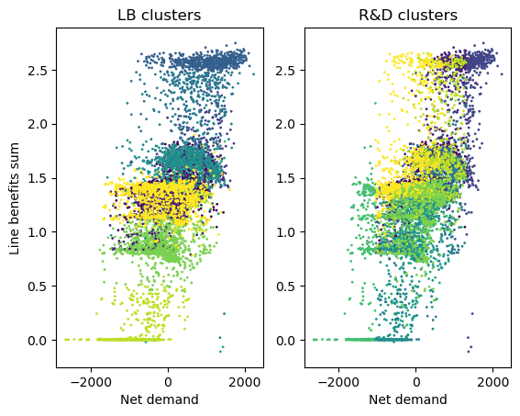
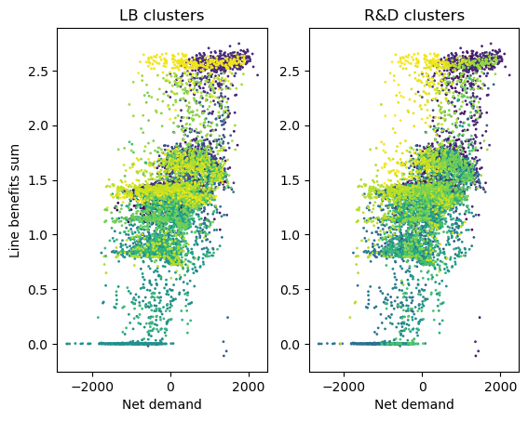
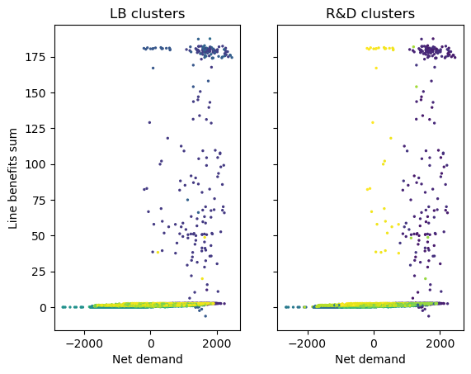
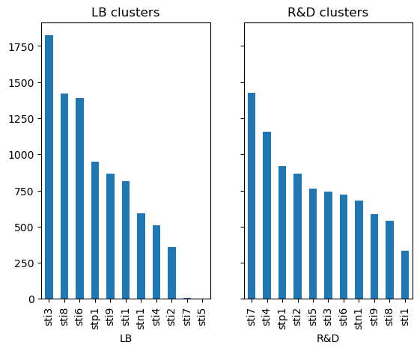
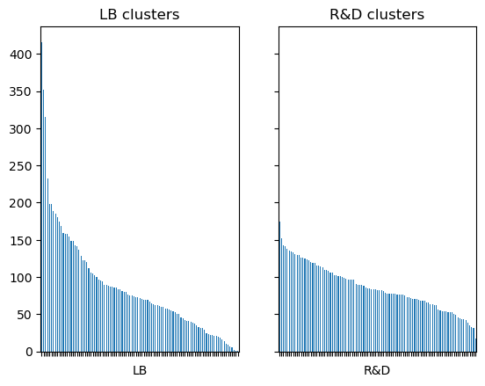
Benchmarking: Operational states for RTS24
K=10
K=100

Slide 16
Benchmarking

Slide 17
Next Steps

